Slide 1
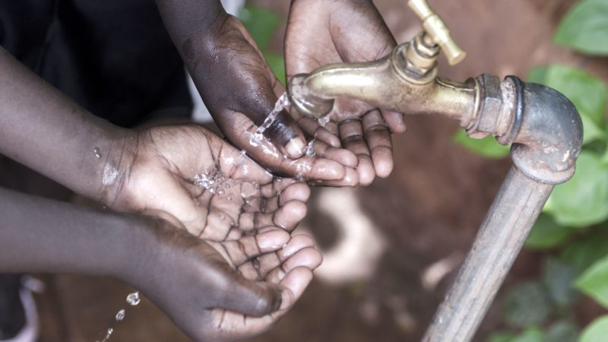
Islamic Microfinance
A TOOL FOR PORVERTY ALEVIATION IN AFRICA

Slide 2
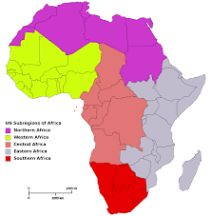
OUTLINE
Introduction
The Necessity of Islamic Microfinance
Three driving pillars of Islamic Microfinance
Poverty in Africa
Causes of poverty in Africa
Why Islamic Microfinance will thrive and make positive impact in Africa
Islamic Microfinance product that are relevant in Africa n Space
Conclusion

Slide 3
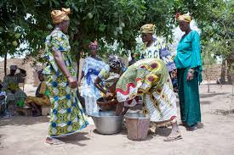
First things first: What is Microfinance?
Microfinance can be easy summarized to mean making microloans accessible to small business and poor entrepreneurs who do not have means to access banking and other related aid services.

Slide 4
The Necessity of Islamic Microfinance
ECONOMIC JUSTICE
The dire need of financial mechanism that will support the most vulnerable of the society
High interest rate associated with the conventional lending institutions as such creating a non-chronological economic system
The geometric increase of Muslim population globally
Promoting efforts of SMEs
FULFILING RELIGIOUS OBLIGATIONS

Slide 5
3 Key Driving Pillars of Islamic Microfinance
FINANCIAL INCLUSION
Access to financial services
SPUR ECONOMIC ACTIVITIES
SMEs funding avenue
INFRASTRUCTURE FUNDING
Sukuk/funds/project financing

Slide 6
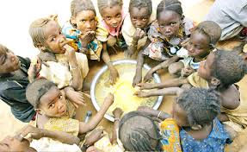
POVERTY IN AFRICA
POVERTY IN AFRICA
Of the 1.2 billion who live on less than a dollar per day, 24.3% are in sub-Saharan Africa
Severe Economic hardship and deteriorating levels of economic performance
34 of the 50 nations on the UN list of least developed countries are in Africa

Slide 7
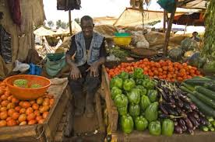
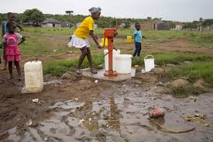
Causes of Poverty in Africa
OTHER CAUSES
Political Instability
Corruption & poor governance
Lack of proper education
Limited employment opportunities
Inadequate access to market
It is widely accepted that one major causes of poverty in developing countries is lack of productive capital with formal financial institutions mostly excluding the poor in their lending activities (Chirwa, 2002)

Slide 8
Concept of Poverty in Islam
Prophet Muhammad said:
“O Allah, I seek Your refuge from poverty, insufficiency and lowliness” (Abu Dawud),
“Poverty is almost like disbeliefin Allah” (Al-Bayhaqi)
Islam views poverty as a religious and social problem that can push a person into “lowliness, sin and crime” (Hassan and Alamgir 2002)

Slide 9
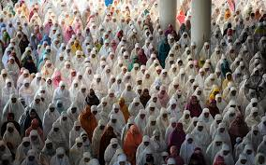
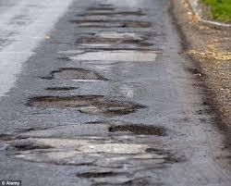
Why Islamic microfinance will thrive and make positive impact in Africa
Through a number of impacts analyses it has been proven at the international level that Microfinance programmes contribute to the achievement of several aspects of the Millennium Development Goals (MDGs) including poverty reduction;
The continent has a Muslim population of approximately 636 million, representing almost 53 percent of Africans.
a vast infrastructure development deficit creates financing needs, towards which Islamic finance could make a significant contribution.

Slide 10
Islamic Microfinance Product that are relevant in the African space

Slide 11
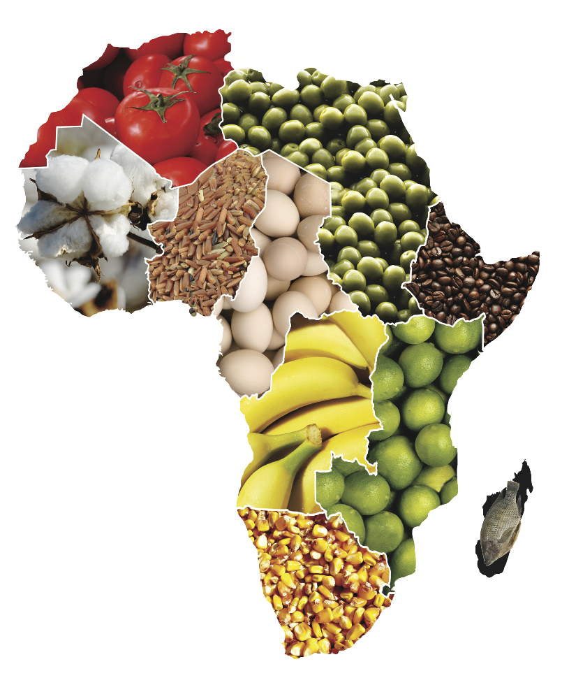
SALAM
This Islamic Microfinance product, has been tested and trusted. It favors the agricultural sector as farmers would be able to finance production in exchange of future delivery . Introducing this product in the Africa agricultural sector will help small scale farmers to leave beyond poverty line in a very short period
According to the World Bank, around 60% of the world’s arable land that is currently not under cultivation is found in Africa.
Increasing agricultural entrepreneurship and commercial farming
Positive impact
It will increase income generation for farmers
Positive impact
It will reduce hunger index
Positive impact
Guaranteed food security
endowed with a wide diversity of agro-ecological zones

Slide 12
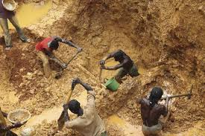
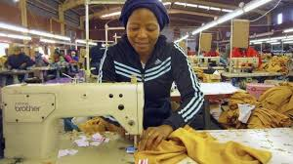
ISTISNA
This product will be very relevant in both the small scale mining and manufacturing sectors of Africa . The key advantage of an istisna’ contract is that it can provide flexibility to the customer, where payments can be made in instalments linked to project completion, at delivery or after project completion.
Artisanal/small scale manufacturers
This sector provide over 50 million direct employment in sub-Saharan Africa
It is associated with low tech and labor intensive
Impact of Istisna product
Provide finance to acquire useful mining & manufacturing tools therefore increasing output
Create a ready market for mineral sales

Slide 13
QARD HASSAN (BENEVOLENT LOAN)
Poverty alleviation
just distribution of national income between all citizens
Unemployment reduction
Building of schools and hospitals through waqf
Loans such as this are used as an attempt to alleviate poverty and create economic growth. In most African society a little income as small as $10 will help do lots of wonders.

Slide 14
Murabaha
Purchase of irrigation and food processing facilities
Mortgage financing
Job Creation
Areas Murabaha will impact
The purpose of murabaha is to finance a purchase without involving interest payments. This can be useful in helping families own assets like housing and advanced technological tools to maximize Agricultural and manufactural outputs

Slide 15
Musharaka and Mudaraba
These are profit and loss sharing sharia compliant product which can help entrepreneurs to grow their businesses in Africa. A well structured Mudaraba and musharaka by Islamic Microfinance institutions will increase the income of entrpreneurs there by advancing industrialization and trade

Slide 16
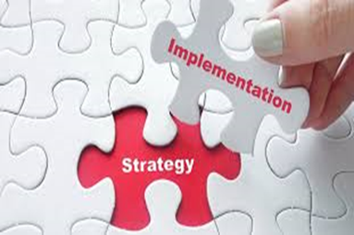
Implementation Strategy
The Government
The Private Sector
The General Masses
Islamic Microfinance on its own cannot eliminate poverty, therefore certain stakeholders must play vital roles For successful implementation

Slide 17
Continuation
ROLE OF GOVERNMENT
i. Establish polices that will favor the general concept of IMF
Ii. Create enabling environment for private investors
Iii. Educate the masses on skill acquisition
Iv. Initiatate sharia compliant micro credit facilities
ROLE OF THE PRIVATE SECTOR
i. They should investment more on micro credit institutions
ii. They should facilitate the awareness through their institutions by developing useful banking products such as group lending, mobile banking and village banking mechanisms
ROLE OF THE Masses
i. The masses should be prepared for transformation through immediate response to Government or Private interventions
ii. They should display high level of trustworthiness
iii. They should develop certain relevant skills so as to improve and increase their income sources and standard of living

Slide 18
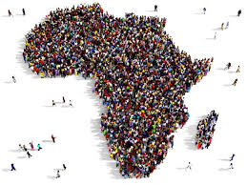
CONCLUSION
For Africa to advance from its present poverty situation, she needs a just and chronological financing mechanism which will help the over 50% vulnerable population access financial services at low cost

Slide 19
LCM CONSULTING TEAM

Slide 20
THANK YOU FOR LISTENING

